Slide 1
finally vs. finalize
Both finally block and finalize() method are used to close the resources used by the program.
finally | finalize
finally block is used to close the resources soon after their use. | finalize() method is used to close the resources before an object is removed from the memory. That means if you use finalize() method to close the resources, they will remain open until an object, which is using them, is garbage collected. But, using finalize() method to close the resources is less recommended as it is not guaranteed that garbage collector will always call finalize() method on an object before it is removed from the memory. If it is not called, the resources will remain open. Therefore, it is always good to close the resources soon after their use using finally block.

Slide 2
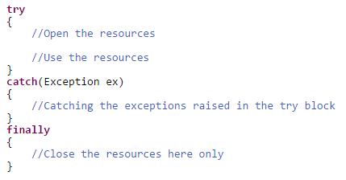
finally vs. finalize
finally block

Slide 3

finally vs. finalize
finalize() method is a protected method of java.lang.Object class. It is inherited to every class you create in java.
finalize() method is called by garbage collector thread before an object is removed from the memory.
finalize() method is used to perform some clean up operations on an object before it is removed from the memory.

